Slide 1
STRINGS (String Operations)
LESSON 4

Slide 2
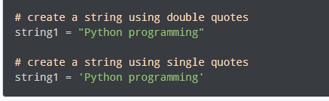
PYTHON STRINGS
In computer programming, a string is a sequence of characters.
For example, "hello" is a string containing a sequence of characters 'h', 'e', 'l', 'l', and 'o'.
We use single quotes or double quotes to represent a string in Python. For example,

Slide 3
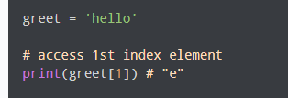
PYTHON STRINGS
Access String Characters in Python
We can access the characters in a string in three ways.
Indexing: One way is to treat strings as a list and use index values. For example,

Slide 4
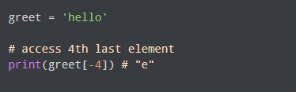
PYTHON STRINGS
Access String Characters in Python
Negative Indexing: Similar to a list, Python allows negative indexing for its strings. For example:

Slide 5
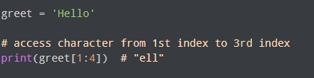
PYTHON STRINGS
Access String Characters in Python
Slicing: Access a range of characters in a string by using the slicing operator colon :. For example,

Slide 6
PYTHON STRINGS
Access String Characters in Python
Note: If we try to access an index out of the range or use numbers other than an integer, we will get errors.

Slide 7

PYTHON STRINGS
Python Strings are immutable
In Python, strings are immutable. That means the characters of a string cannot be changed. For example,

Slide 8
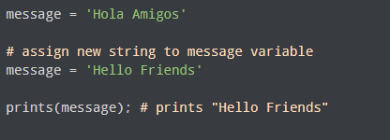
PYTHON STRINGS
We can Assign New String to String Variable

Slide 9
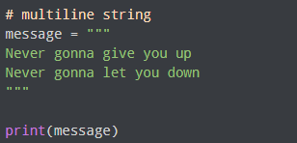
PYTHON STRINGS
Python Multiline String
We can also create a multiline string in Python. For this, we use triple double quotes """ or triple single quotes '''. For example,

Slide 10
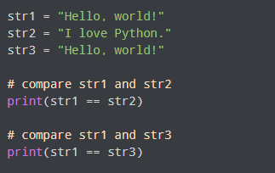
PYTHON STRINGS
Python String Operations
There are many operations that can be performed with strings which makes it one of the most used data types in Python.
1. Compare Two Strings
We use the == operator to compare two strings. If two strings are equal, the operator returns True. Otherwise, it returns False. For example,

Slide 11
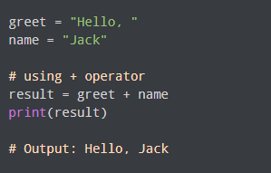
PYTHON STRINGS
Python String Operations
2. Join Two or More Strings
In Python, we can join (concatenate) two or more strings using the + operator.

Slide 12
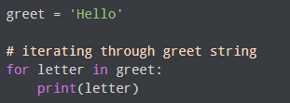
PYTHON STRINGS
Iterate through a String
We can iterate through a string using a for loop. For example,

Slide 13
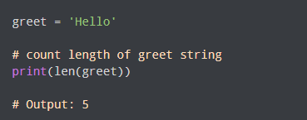
PYTHON STRINGS
String Length
In Python, we use the len() method to find the length of a string. For example,

Slide 14

PYTHON STRINGS
Membership Test
We can test if a substring exists within a string or not, using the keyword in.

Slide 15
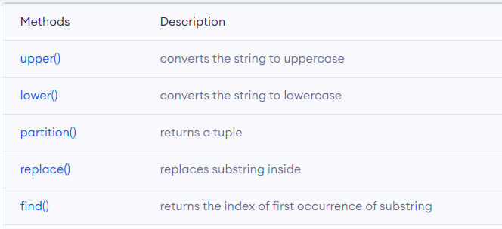
PYTHON STRINGS
Methods
Besides those mentioned above, there are various string methods present in Python. Here are some of those methods:

Slide 16
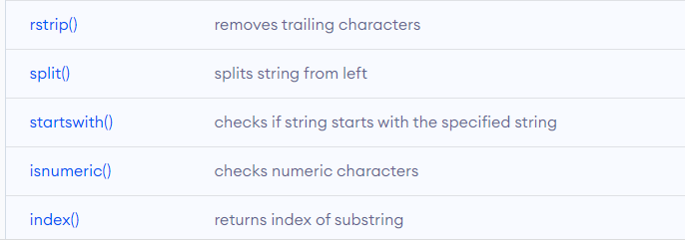
PYTHON STRINGS
Methods

Slide 17
STRING FORMATTING --- lower()/upper() ----- rstrip () ----- lstrip()

